Slide 1
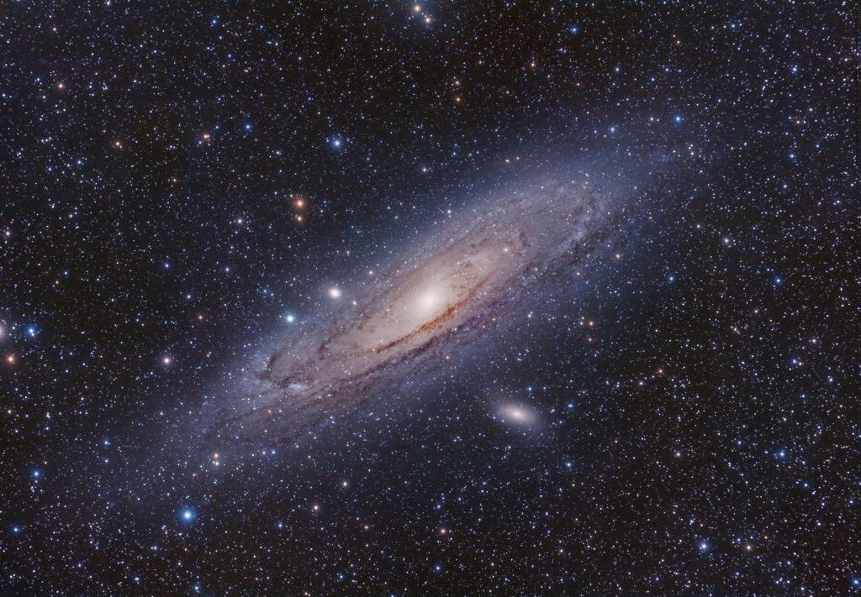


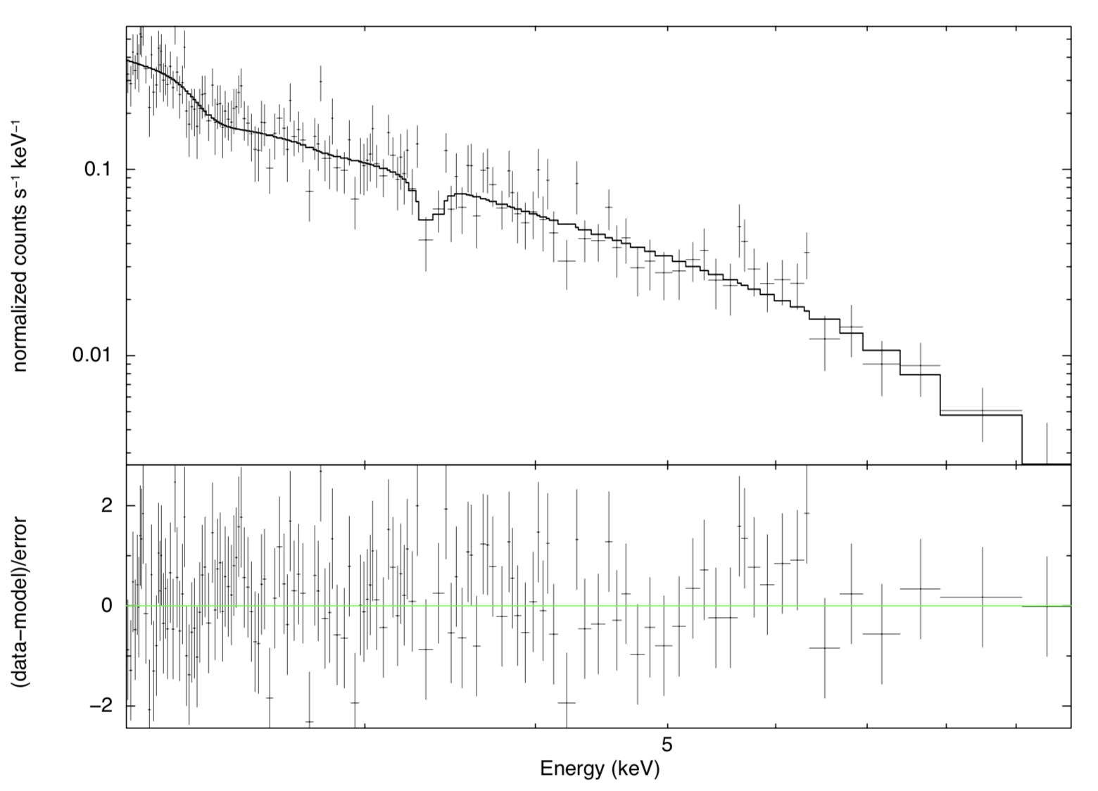

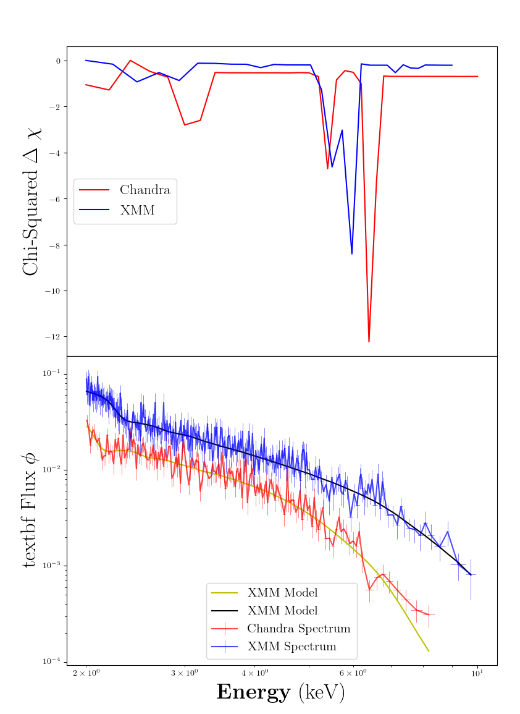
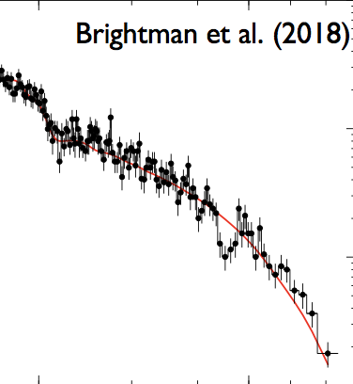







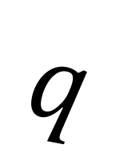


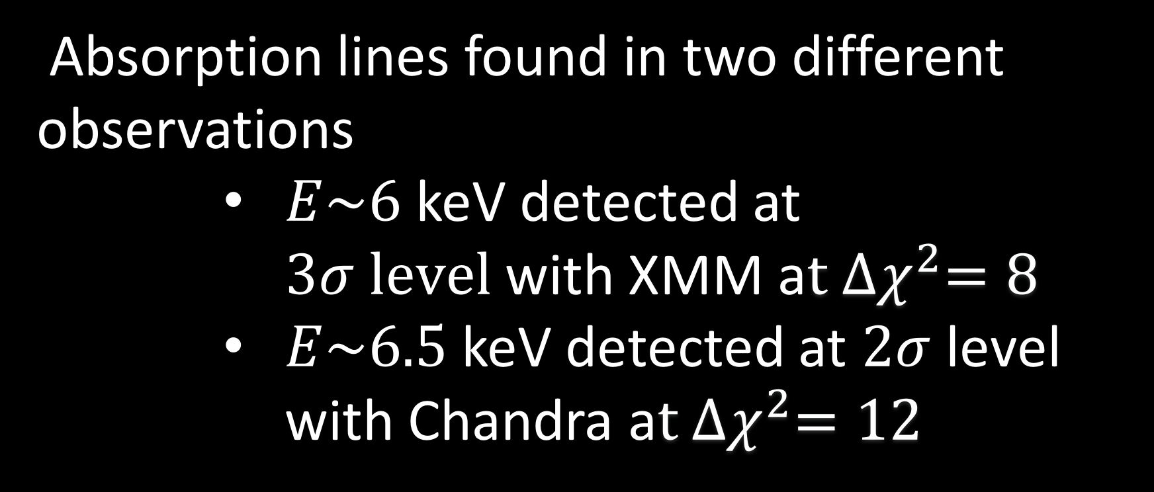
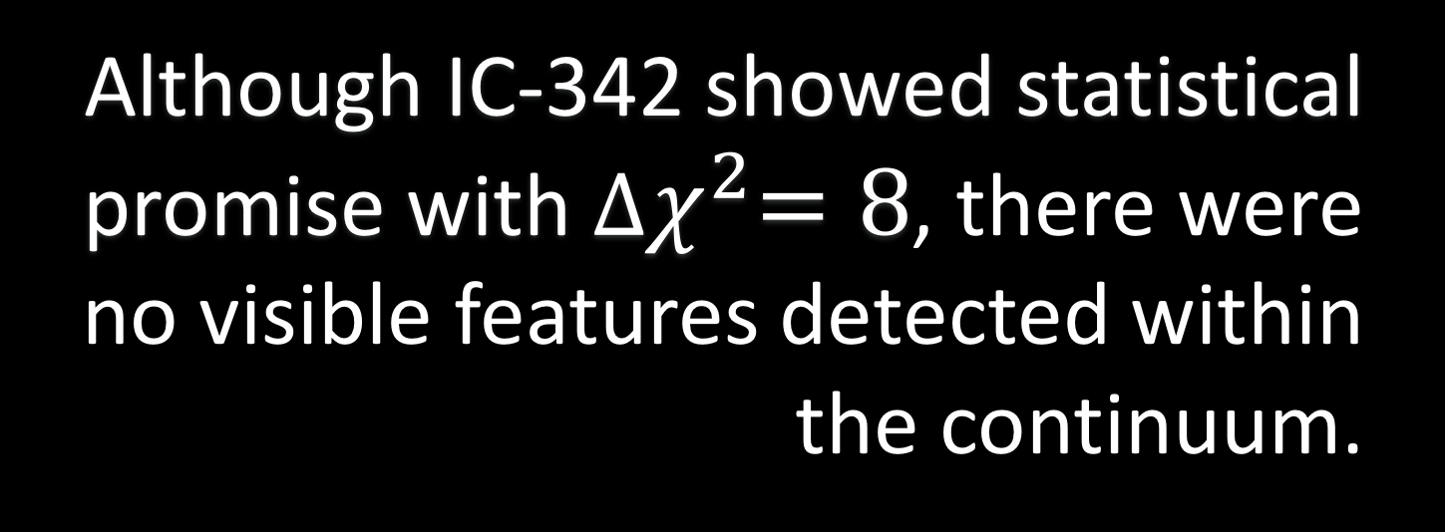

A systematic search for absorption features in the X-ray spectra of ultraluminous X-ray sources
A. Sosanya^{1,2}, M. Brightman¹, F.A Harrison¹, M. Heida¹, H.P Earnshaw¹, K. Madsen¹
California Institute of Technology, Pasadena, US
Dartmouth College, Hanover, NH
STAR POWER
Ultraluminous X-ray sources (ULXs) are variable, non-nuclear, bright X-ray sources in nearby galaxies independent of the central supermassive black hole. These ULXs are brighter than black hole systems in our galaxy—they have super-Eddington luminosities greater than stellar mass black holes. These ULXs break Eddington theory because of extreme accretion rates onto a compact stellar remnant, or an intermediate mass black hole.
Using the data from the XMM-Newton and Chandra X-ray observatories, we conducted a systematic search to find cyclotron resonance scattering features in the X-Ray spectra of ULXs to identify neutron-star powered ULXs. The results provide further insight into the analysis techniques for future neutron star-powered ULXs and estimation of their magnetic field strengths.
RESULTS
The search found three strong candidates for analysis: Holmberg II, IC 342, and M32.
HOLMBERG II
EDDINGTON LUMINOSITY
Absorption feature detected in Holmberg II at $E\sim 3.35$ keV, yet ${∆χ}^{2}=6$
The Eddington Luminosity is the maximum luminosity a star attains when radiation pressure from the star and gravitation pressure are balanced.
(Left) XSPEC plot of Holmberg II spectrum, shjowing absorption feature at 3.3 keV. (below) XMM-Newton X-Ray Observatory
NS
$\frac{dP}{dr}=\frac{kp}{c}F_{rad}$ = $\frac{GMp}{r^{2}}$, where $F=\frac{L}{4πr^{2}}$
$${ L}_{ed}=\frac{4πGc}{k}M$$
$${ G}_{NS}$$
$$F_{rad}$$
CRSFs
$$E_{2}$$
$$E_{3}$$
The energy transitions between Landau levels induce CRSFs and are present in spectra. Cyclotron lines imply the presence of a magnetized neutron star and give a measurement of its field strength.
$$q$$
$$E_{1}$$
$$B$$
$$E=0$$
IC-342
$E=5$ keV detected at $2σ level$in XMM observation with ${∆χ}^{2}=8$
(Above)
A 2-D representation of Landau levels
Although IC-342 showed statistical promise with ${∆χ}^{2}=8$, there were no visible features detected within the continuum.
(Right) Cyclotron line found in M51’s ULX-8 found by M.Brightman, now believed to be neutron-star powered.
METHODS
M32
SYSTEMATIC SEARCH
The ULXs observed in M32 are proximate to each other, and therefore needed Chandra data for spatial resolution.
Cross-referenced the Serendipitous XMM-Survey to find ULXs with at least 10,000 intensity counts.
Absorption lines found in two different observations
$E\sim 6$ keV detected at $3σ level$with XMM a$t {∆χ}^{2}=8$
$E\sim 6.5$keV detected at $2σ$ level with Chandra a$t {∆χ}^{2}=12$
SPECTRAL ANALYSIS
Reduced XMM/Chandra data and found favorable spectral extraction parameters using Chi Squared test.
Used spectral fitting software XSPEC to analyze detector data and fitted the spectra with a coupled cutoff power law continuum and Gaussian absorption (zgauss).
Ran simulations to assess false alarm rates.
(Right) Contour and flux plots of Chandra and XMM observations of M32
CONCLUSION
CONCLUSION
Different energies between XMM/Chandra M32 observation may be due to
the magnetic field orientation changing between observations.
possibility of an Iron outflow at one of the energies.
a statistical fluctuation in spectral data
contributions from the two proximate X-Ray sources are additive.
Holmberg II and M32 show the absorption-like features that may be either cyclotron lines or atomic. To consolidate our findings, spectral data needs to be compared across detectors. Future observations are needed to gather more data on these sources.
ACKNOWLEDGEMENTS
Caltech WAVE Fellows Program
SoCal Edison
REFERENCES
M. Brightman et al. 2018
H.P. Earnshaw et al. 2018
M. Bachetti et al. 2014
D.J Walton et al. 2016

